Slide 1
Mid-term Review
Xue Gao

Slide 2
Summary
Concepts
Supervised vs Unsupervised learning
Interpretation vs. Flexibility
Training vs. Test errors
Bias-Variance tradeoff
Regression vs. Classification
Parametric vs. non-Parametric Model
OLS vs. MLE
Models:
Linear regression
Logistic regression
K-Nearest Neighbors
Discriminant Analysis
LDA
QDA
Resampling methods:
Bootstrap
Cross-validation

Slide 3
What is Statistical Learning?
Statistical learning refers to a vast set of tools for understanding data. These tools can be classified as supervised or unsupervised.
Supervised statistical learning involves building a statistical model for predicting, or estimating, an output based on one or more inputs. Problems of this nature occur in fields as diverse as business, medicine, astrophysics, and public policy.
With unsupervised statistical learning, there are inputs but no supervising output; nevertheless we can learn relationships and structure from such data.

Slide 4
Regression vs. Classification
Regression: quantitative response variable
Classification: qualitative response variable
But the distinction is not always clear. For example, logistic regression can be thought of both as a classification and a regression approach
It estimates the probability of a unit belonging to a certain class.
We tend to select statistical learning methods on the basis of whether the response is quantitative or qualitative; i.e. we might use linear regression when quantitative and logistic regression when qualitative. However, whether the predictors are qualitative or quantitative is generally considered less important. Most of the statistical learning methods discussed in this course can be applied regardless of the predictor variable type, provided that any qualitative predictors are properly coded before the analysis is performed (next class).

Slide 5
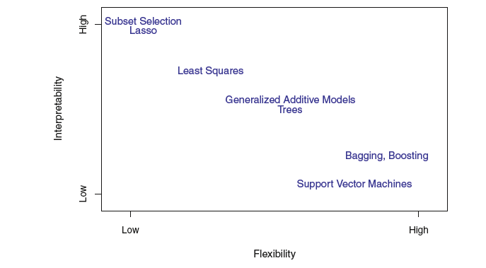
Some Important Aspects of Statistical Learning: Recurring Themes in the Course
Interpretation vs. Flexibility (predictive accuracy, often)
Model selection: choosing the best model for a problem/data
Overfitting
Training vs. Test errors
Bias-Variance tradeoff

Slide 6
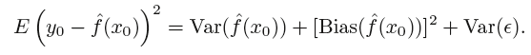
Bias-Variance Trade-off

Slide 7
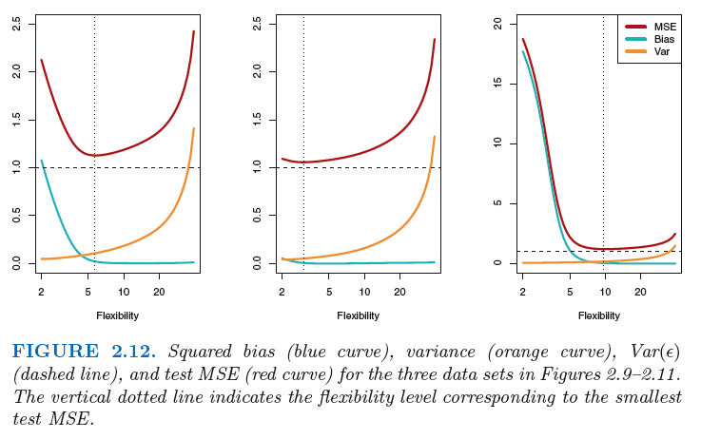
Bias-Variance Trade-off related to flexibility
Notes:
Overfitting happens when a model learns the detail and noise in the training data to the extent that it negatively impacts the performance of the model on new data.
models with a large number of free parameters can describe an amazingly wide range of phenomena and can fit any amount of data available. Even if such a model agrees well with the available data, that doesn’t make it a good model.
Additional insight: https://towardsdatascience.com/deep-learning-overfitting-846bf5b35e24

Slide 8
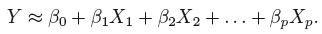
How Do We Estimate f? Parametric Approach
Two-step process
Step 1: Assume functional form for f. For example, a very simple assumption is that f is linear in X:
Step 2: Estimate the parameters/coefficients using a fitting procedure (say, least squares) on training data:
parametric because it reduces the problem of estimating f down to one of estimating a set of parameters.
Notes:
Assuming a parametric form for f simplifies the problem of estimating f because it is generally much easier to estimate a set of parameters, such as β₀, β₁, . . . , β_{p} in the linear model (2.4), than it is to fit an entirely arbitrary function f.
The potential disadvantage of a parametric approach is that the model we choose will usually not match the true unknown form of f. If the chosen model is too far from the true f , then our estimate will be poor.
We can try to address this problem by choosing flexible models that can fit many different possible functional forms flexible for f.
But in general, fitting a more flexible model requires estimating a greater number of parameters. These more complex models can lead to a phenomenon known as overfitting the data, which essentially means they overfitting follow the errors, or noise , too closely.

Slide 9
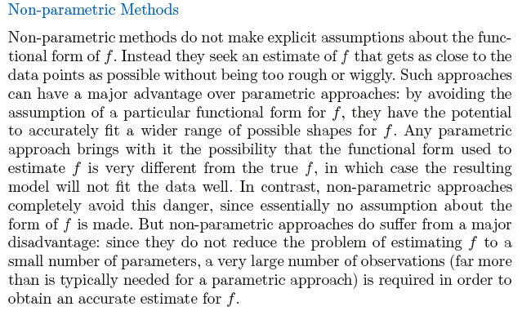
How Do We Estimate f? Non-Parametric Approach
Notes:
Non-parametric methods do not make explicit assumptions about the functional form of f . Instead they seek an estimate of f that gets as close to the data points as possible without being too rough or wiggly. Such approaches can have a major advantage over parametric approaches: by avoiding the assumption of a particular functional form for f , they have the potential
to accurately fit a wider range of possible shapes for f . Any parametric approach brings with it the possibility that the functional form used to
estimate f is very different from the true f , in which case the resulting
model will not fit the data well. In contrast, non-parametric approaches
completely avoid this danger, since essentially no assumption about the
form of f is made. But non-parametric approaches do suffer from a major
disadvantage: since they do not reduce the problem of estimating f to a
small number of parameters, a very large number of observations (far more
than is typically needed for a parametric approach) is required in order to
obtain an accurate estimate for f .

Slide 10
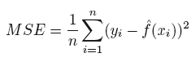
Measuring the Quality of Fit
Training MSE vs. Test MSE
Training MSE: MSE on the sample used to fit the model
But often the interest is (should be?) in knowing how the model performs outside the sample that was used to fit
Analogy: Practice exam vs. Real final exam
Test data (x₀,y₀)
Test MSE (for many test observations):

Slide 11
Linear Regression
Supervised learning
a useful tool for predicting a quantitative response
least squares approach (Estimating the Coefficients)
Is there a relationship between X and Y?
How strong is the relationship between predictors and response variable?
Which predictor contributes to the response variable?
How accurately can we estimate the effect of each predictor on response variable?
How accurately can we predict future outcome?
Is the relationship linear?
Should we consider interaction?
Notes:
The standard error tells us the average amount that this estimate u(hat) differs from the actual value of u.

Slide 12
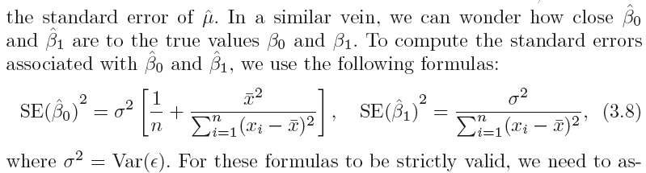
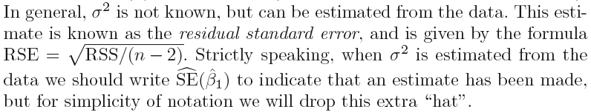
Standard Errors for OLS Estimates
Notes:
Epsilon is the stochastic error term in equation 3.5, which represents the population regression line (PRL).

Slide 13
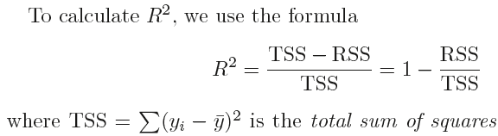
R² Statistic
The R² statistic provides a measure of fit. It takes the form of a proportion —the proportion of variance explained—and so it always takes on a value between 0 and 1, and is independent of the scale of Y.
TSS measures the total variance in the response Y, and can be thought of as the amount of variability inherent in the response before the regression is performed.

Slide 14
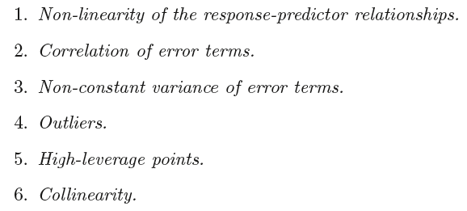
Potential Problems in MLR
Notes:
Begin third session: 60min

Slide 15
Classification: Working with Qualitative Response Variables
Quantitative vs. Qualitative response variables/Regression vs. Classification
In this unit (this and next class), learn: logistic regression; discriminant analysis, and KNN classification
In later units focus on more advanced methods such as trees, random forests, boosting, and support vector machines.

Slide 16
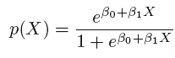
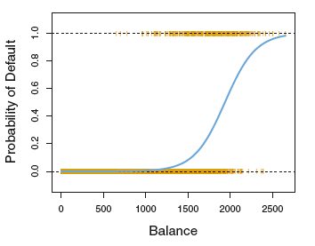
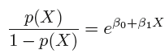
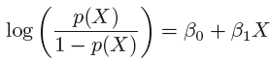
Classification: Logistic Regression
Odds:
Log-Odds:
Notes:
p(X) = Pr(Y = 1 | X)

Slide 17
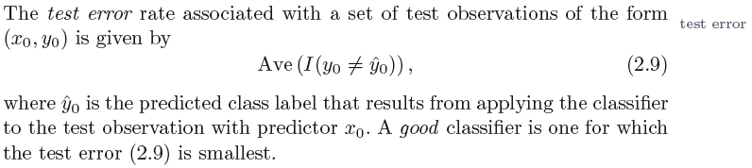
Error in the Classification Setting: Test Error
How would you calculate the test error?

Slide 18
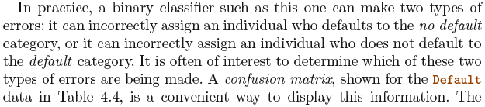
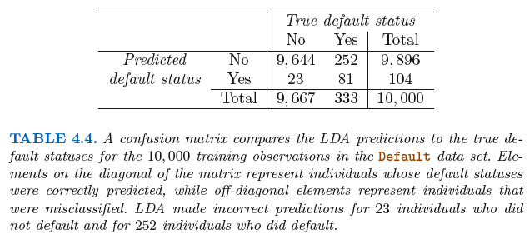
Confusion Matrix
False +ive
True +ive
Notes:
Do we always set the threshold as 0.5?
False +ive, because it’s classified by the model as a ‘default’ (i.e., +ive), but that classification is wrong (i.e., false). So ‘false’ relates to the actual (true) status and ‘+ive’ relates to the predicted status.

Slide 19
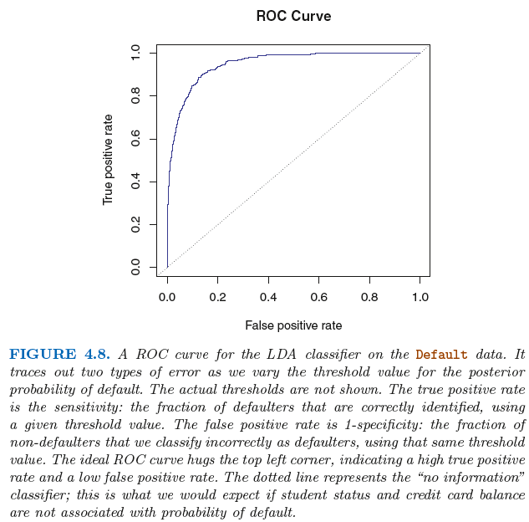
The ROC Curve (Receiver Operating Characteristics)
The overall performance of a classifier, summarized over all possible thresholds, is given by the area under the (ROC) curve (AUC). An ideal ROC curve will hug the top left corner, so the larger area under the (ROC) curve the AUC the better the classifier.

Slide 20
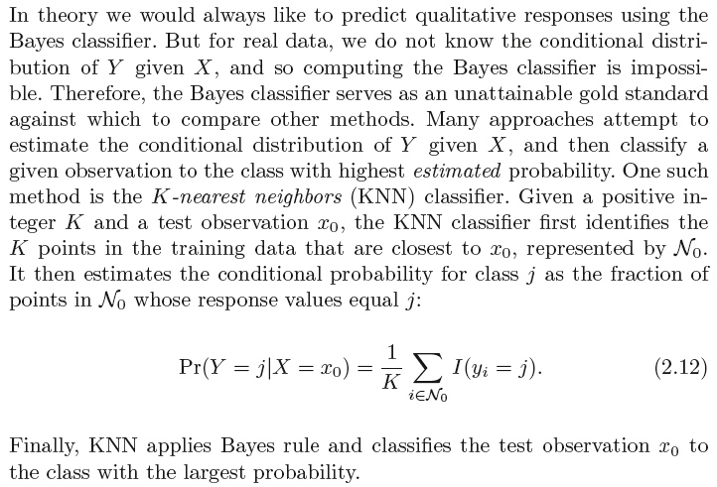
K-Nearest Neighbors (KNN) Classifier

Slide 21
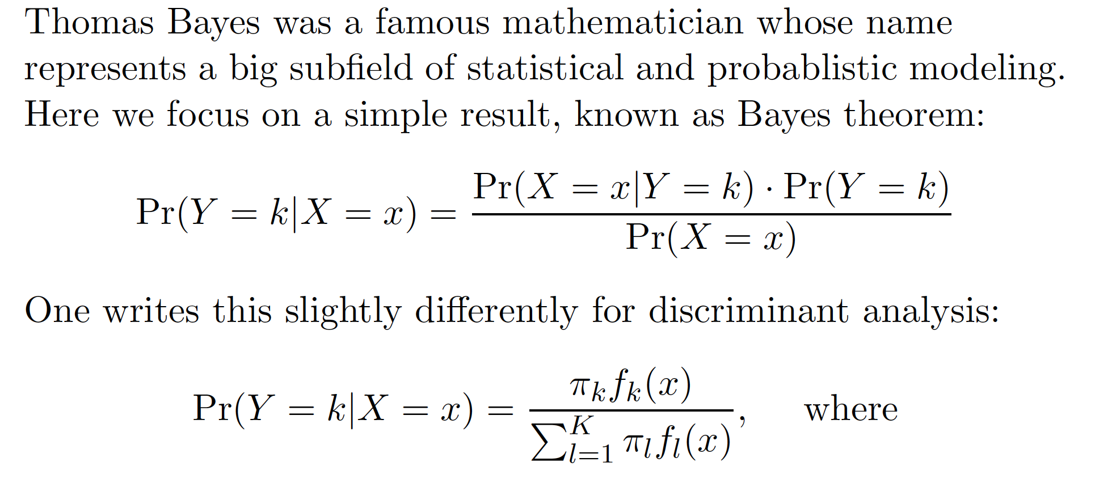
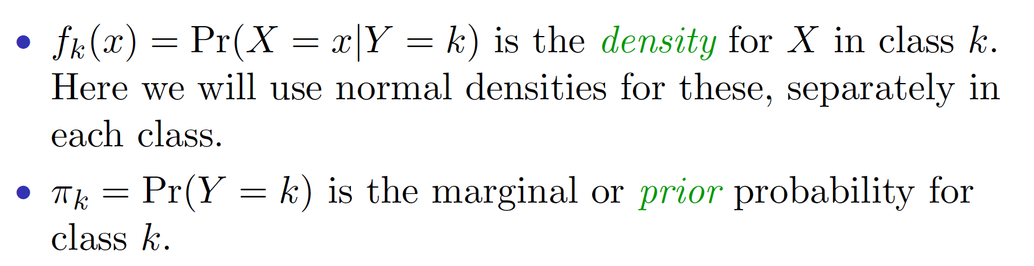
Classification: Discriminant Analysis
Step 1: Model the distribution of X in each of the classes separately
Step 2: Use Bayes theorem to flip things around and obtain Pr (Y | X).

Slide 22
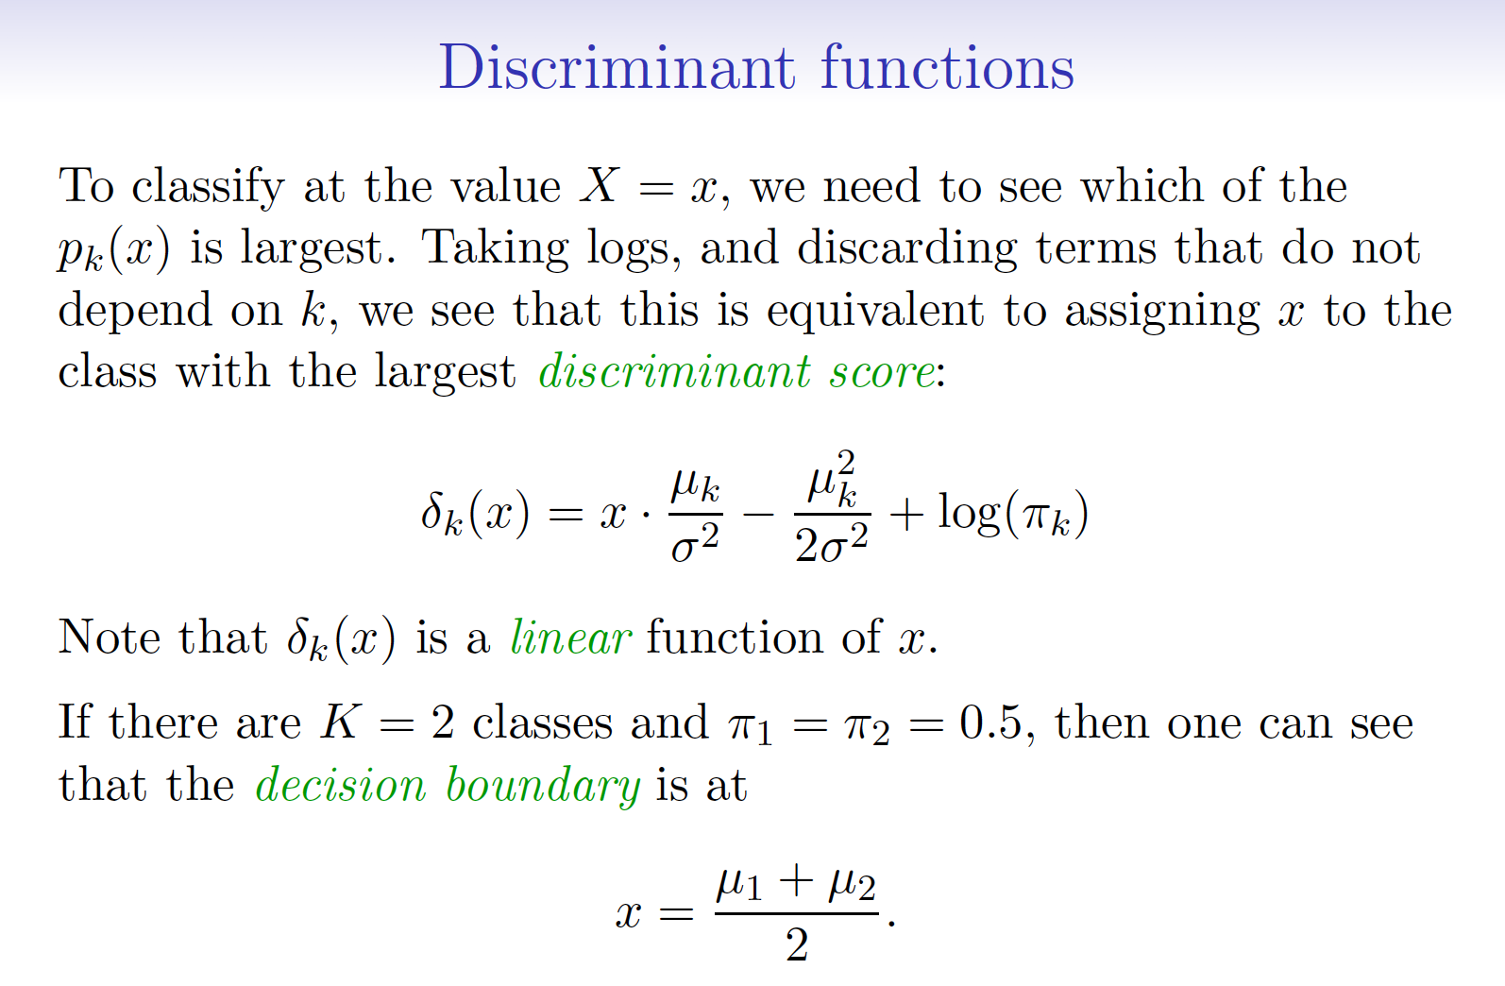
Notes:
QDA assumes a quadratic decision boundary

Slide 23
Resampling methods
Cross-validation and the Bootstrap
When do we need bootstrap?
The bootstrap is a widely applicable and extremely powerful statistical tool that can be used to quantify the uncertainty associated with a given estimator or statistical learning method.
Generally, the bootstrap is used for estimating standard errors and bias, obtaining confidence intervals, and sometimes for tests.
Why do we use CV?
Cross-validation can be used to estimate the test error associated with a given statistical learning method in order to evaluate its performance, or to select the appropriate level of flexibility.

Slide 24
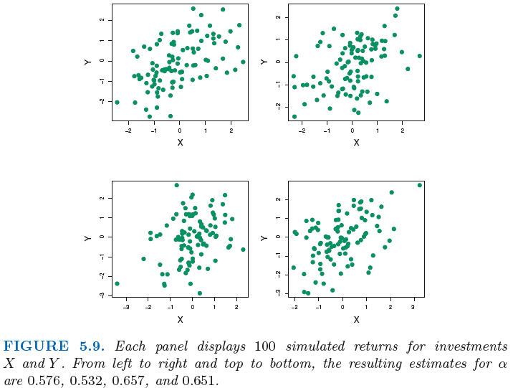
Bootstrap

Slide 25
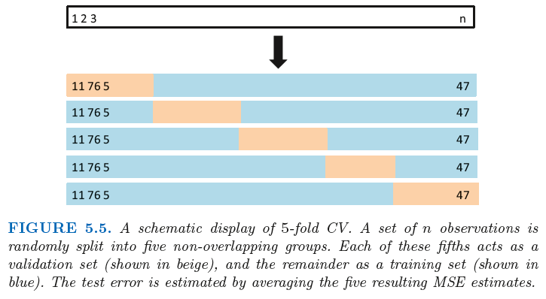
Cross-validation
We consider a class of methods that estimate the test error rate by holding out a subset of the training observations from the fitting process, and then applying the statistical learning method to those held out observations.
Notes:
Random split (validation set approach): overestimate the test error
K-fold CV: randomly dividing into k folds
Leave One Out: This is in contrast to the validation set approach, in which the training set is typically around half the size of the original data set. the LOOCV approach tends not to overestimate the test error rate as much as the validation set approach does.

Slide 26
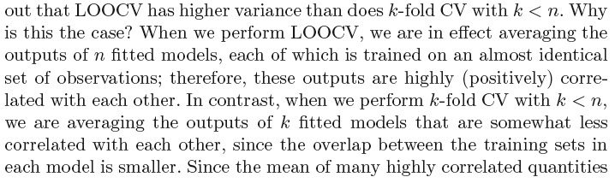
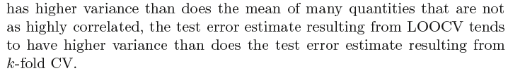
LOOCV vs. k-fold CV: Bias-Variance Tradeoff
Bias: Validation-set vs. LOOCV vs. k-fold CV?
But bias not the only source for concern in an estimating procedure: need to pay respect to variance too!
Notes:
In LOOCV(leave one out CV), you get estimates of test error with lower bias, and higher variance because each training set contains n-1 examples, which means that you are using almost the entire training set in each iteration. This leads to higher variance too, because there is a lot of overlap between training sets, and thus the test error estimates are highly correlated, which means that the mean value of the test error estimate will have higher variance. (so you would get very different estimates if you repeated the estimate with different initial samples of data from the same distribution)
The opposite is true with k-fold CV, because there is relatively less overlap between training sets, thus the test error estimates are less correlated, as a result of which the mean test error value won't have as much variance as LOOCV.

Slide 27
Can the bootstrap estimate prediction error?
To estimate prediction error using the bootstrap, we could think about using each bootstrap dataset as our training sample, and the original sample as our validation sample.
But each bootstrap sample has significant overlap with the original data. This will cause the bootstrap to seriously underestimate the true prediction error.
Cross-validation provides a simpler, more attractive approach for estimating prediction error.

Slide 28
Summary
Concepts
Supervised vs Unsupervised learning
Interpretation vs. Flexibility
Training vs. Test errors
Bias-Variance tradeoff
Regression vs. Classification
Parametric vs. non-Parametric Model
OLS vs. MLE
Models:
Linear regression
Logistic regression
K-Nearest Neighbors
Discriminant Analysis
LDA
QDA
Resampling methods:
Bootstrap
Cross-validation

Slide 29
The End
Good Luck on Your Mid-term Exam!!!!

Slide 30
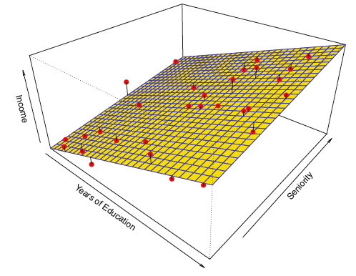
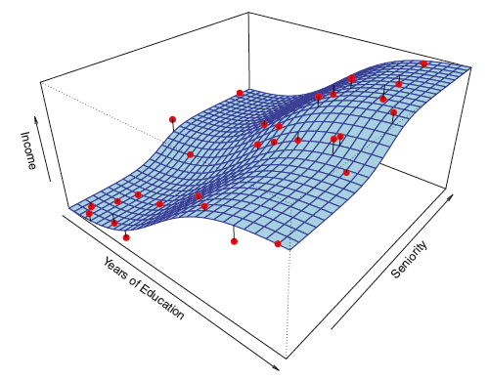
Simple Parametric Model

Slide 31
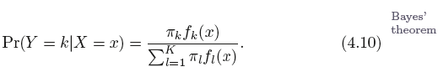
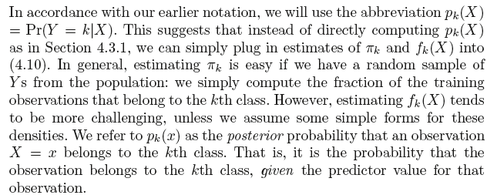
Using Bayes’ Theorem for Classification
prior probability
Notes:
Let π_{k} represent the overall or prior probability that a randomly chosen observation comes from the k^{th} class; this is the (prior) probability that a given observation is associated with the k^{th} category of the response variable Y .

Slide 32
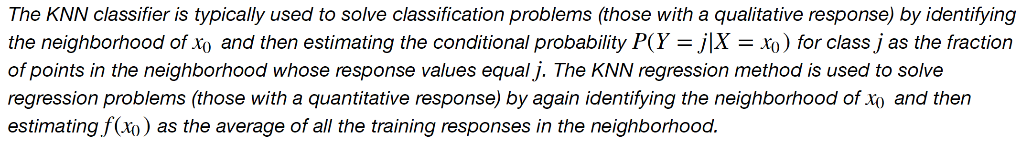

Slide 33
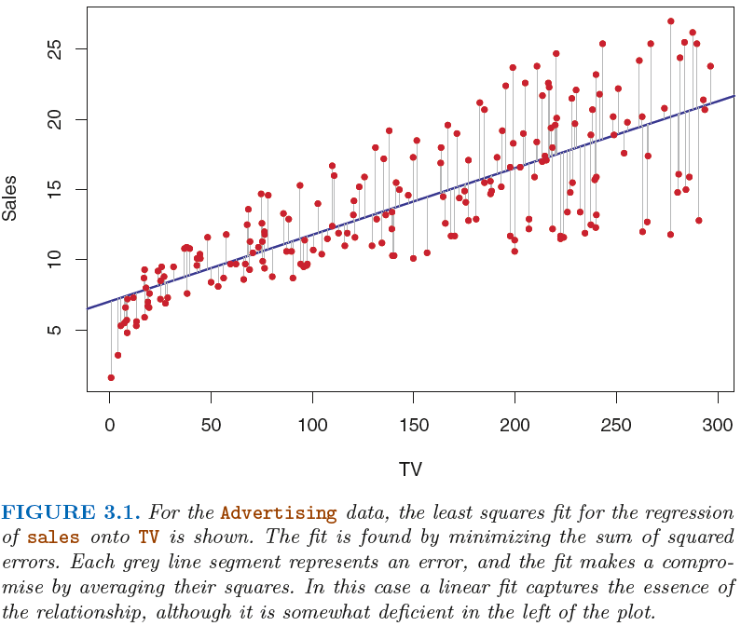
Least Squares Estimation

Slide 34
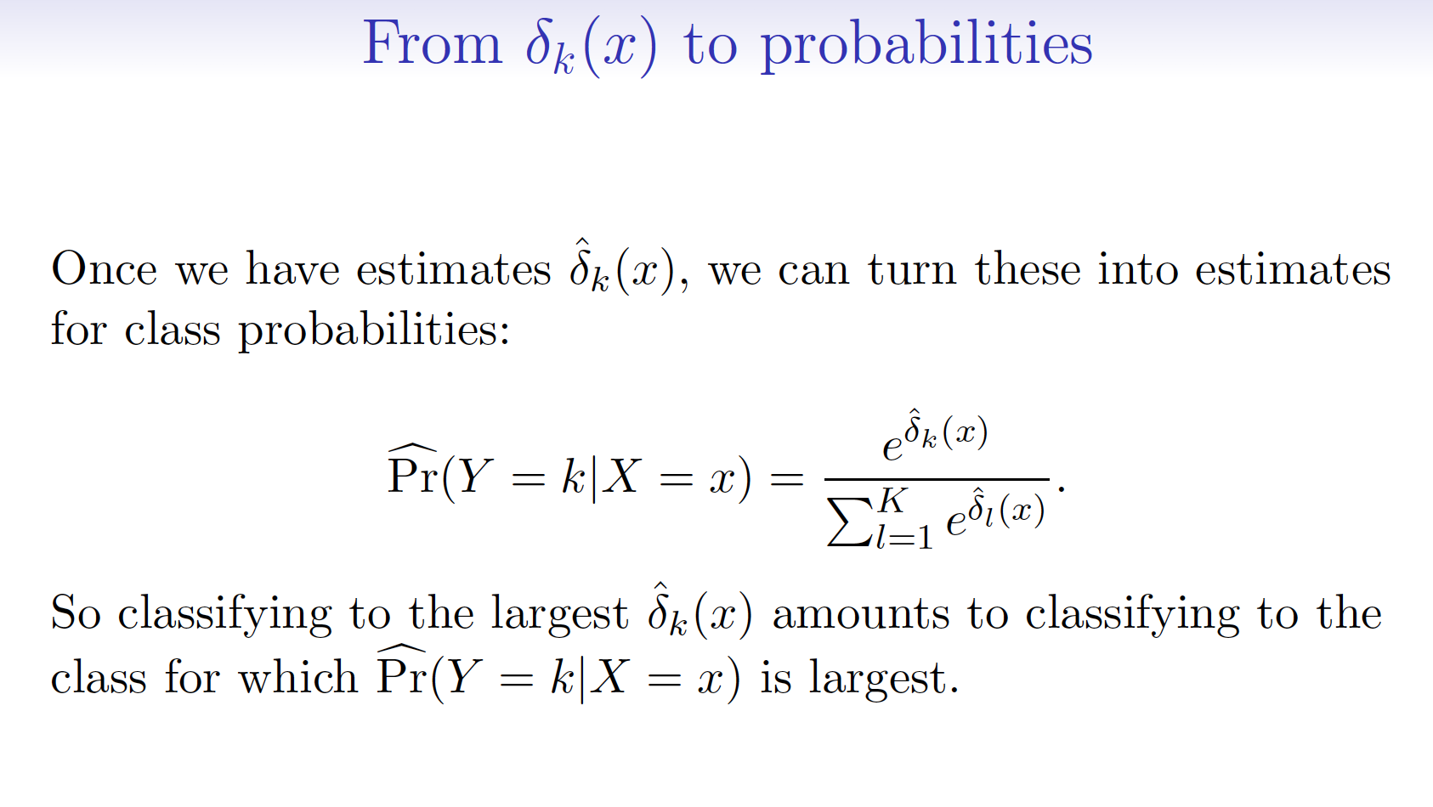

Slide 35
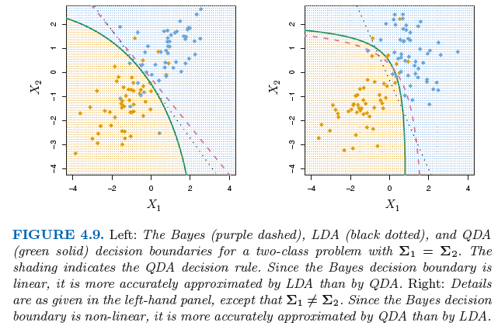
Why Assume that Class Covariance is the Same or Not? That is, Why QDA over LDA?

Slide 36
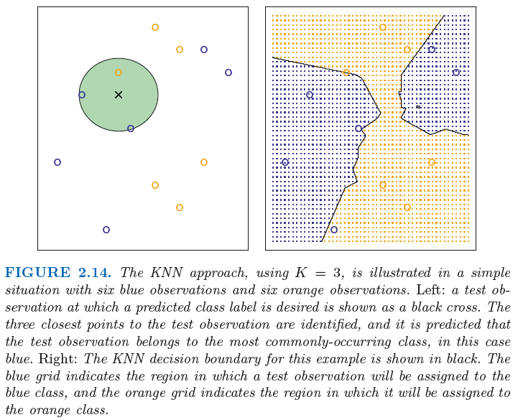
KNN Example

Slide 37


Slide 38
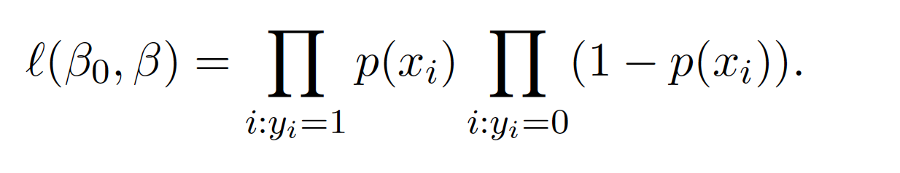
Estimating the Regression Coefficients: The Maximum Likelihood Method
We use maximum likelihood to estimate the parameters.
This likelihood gives the probability of the observed zeros and ones in the data. We pick 0 and 1 to maximize the likelihood of the observed data.

